Slide 1


Azərbaycan Dövlət Neft və Sənaye Universiteti
Calculus
Single Variable

Slide 2
Evaluating Limits Analytically

Slide 3
Outline
Evaluate a limit using properties of limits.
Develop and use a strategy for finding limits.
Evaluate a limit using dividing out and rationalizing techniques.
Evaluate a limit using the Squeeze Theorem.

Slide 4
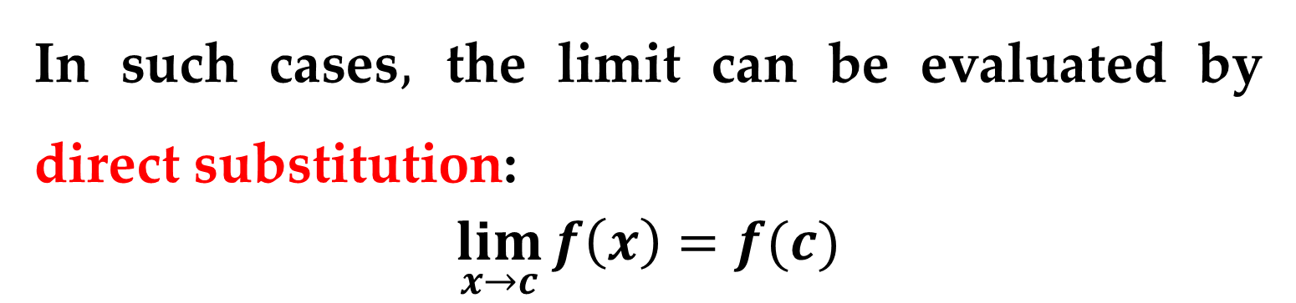
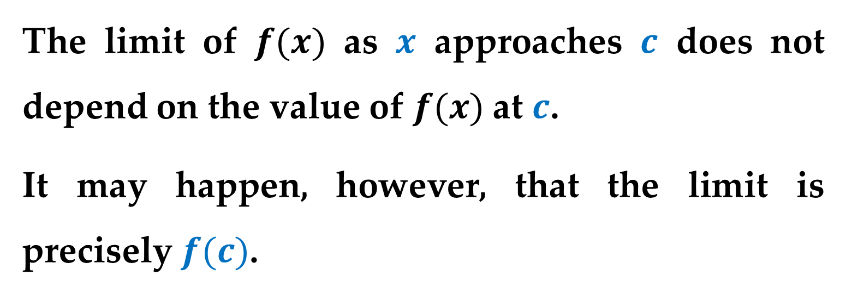
Properties of Limits
The limit of $f(x)$ as $x$ approaches $c$ does not depend on the value of $f(x)$at $c$.
It may happen, however, that the limit is precisely $f(c)$.
In such cases$,$ the limit can be evaluated by direct substitution:
$$\lim_{x→c}{f\left(x\right)=f(c)}$$

Slide 5
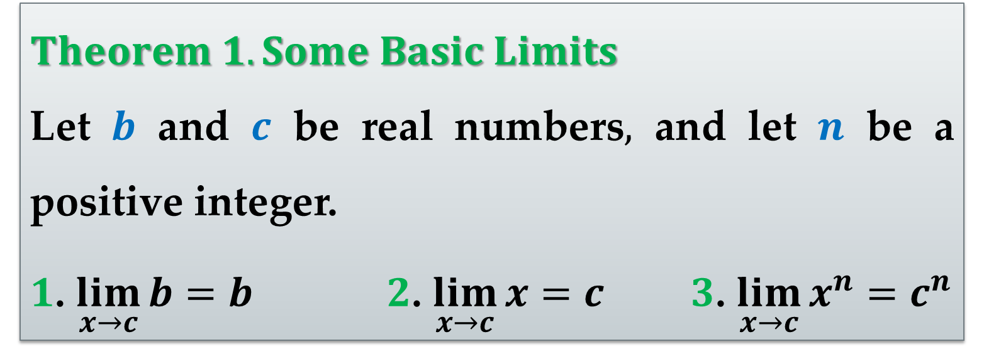
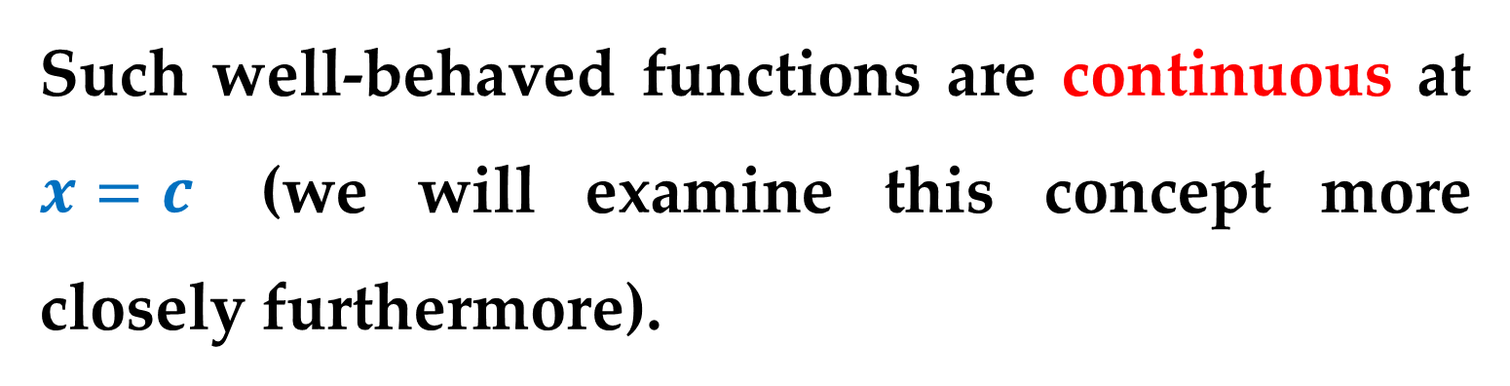
Such well-behaved functions are continuous at $x=c$ (we will examine this concept more closely furthermore).
$Theorem 1. Some Basic Limits$
Let $b$ and $c$ be real numbers$,$ and let $n$ be a positive integer.
$1$. $\lim_{x→c}{b=b}$ $2$. $\lim_{x→c}{x=c}$ $3$. $\lim_{x→c}{x^{n}=c^{n}}$

Slide 6
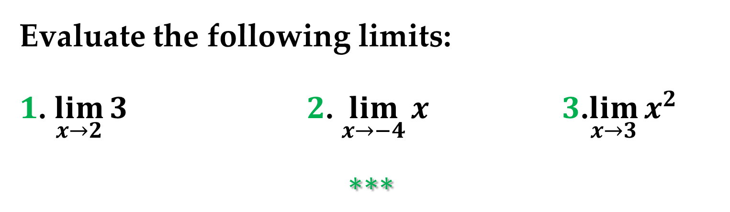
Example 1. Evaluating Basic Limits
Evaluate the following limits:
$1$. $\lim_{x→2}{3}$ $2$. $\lim_{x→−4}{x}$ $3$.$\lim_{x→3}{x^{2} }$
$$∗∗∗$$

Slide 7
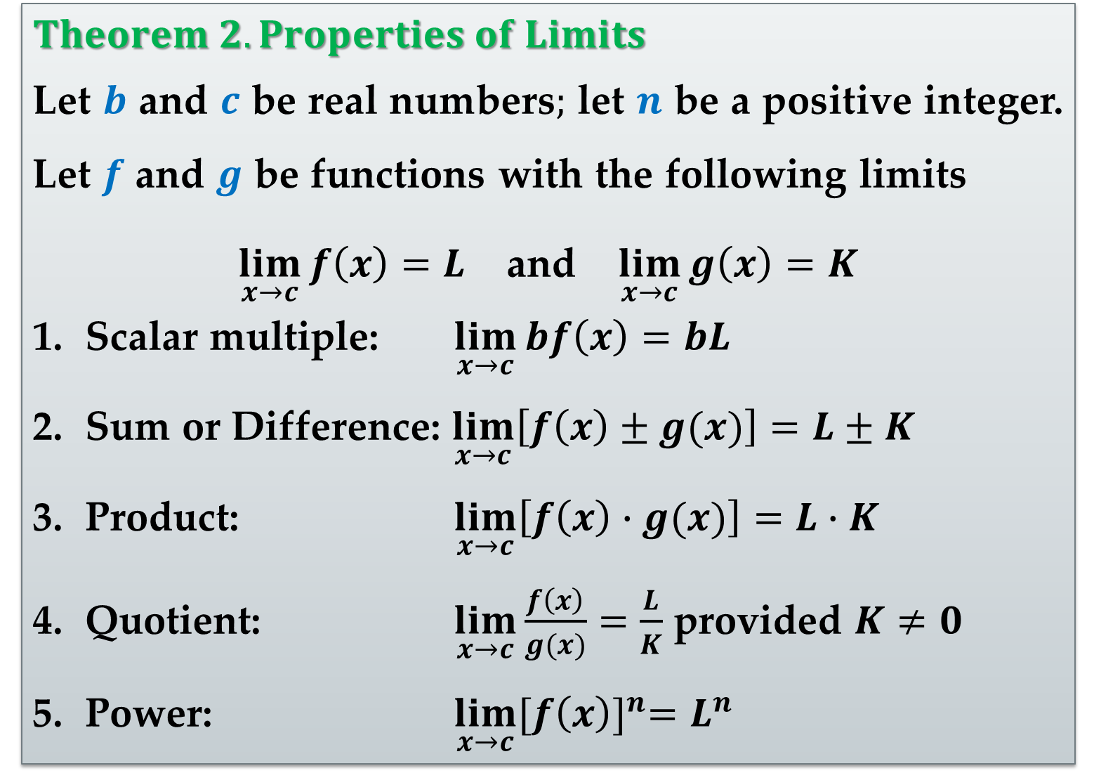
$Theorem 2. Properties of Limits$
Let $b$ and $c$ be real numbers$;$ let $n$ be a positive integer. Let $f$ and $g$ be functions with the following limits
$\lim_{x→c}{f\left(x\right)=L}$ and $\lim_{x→c}{g\left(x\right)=K}$
Scalar multiple: $\lim_{x→c}{bf\left(x\right)=bL}$
Sum or Difference: $\lim_{x→c}\left[f\left(x\right)±g(x)\right]=L±K$
Product: $\lim_{x→c}\left[f\left(x\right)∙g(x)\right]=L∙K$
Quotient: $\lim_{x→c}{\frac{f\left(x\right)}{g(x)}=\frac{L}{K}}$ provided $K≠0$
Power: $\lim_{x→c}{{[f\left(x\right)]}^{n}=L^{n}}$

Slide 8
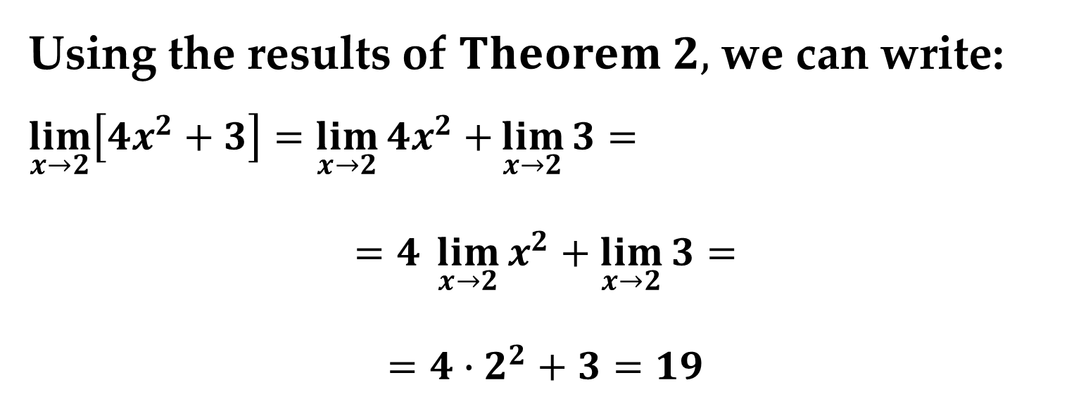
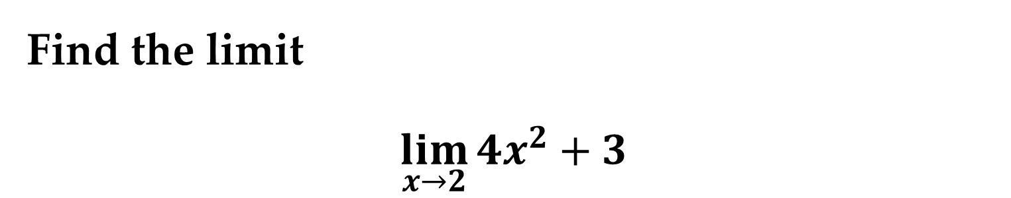
Example 2. The Limit of a Polynomial
Find the limit
$$\lim_{x→2}{4x^{2}+3}$$
Solution
Using the results of $Theorem 2,$ we can write:
$\lim_{x→2}\left[4x^{2}+3\right]=$ $\lim_{x→2}{4x^{2}+}\lim_{x→2}{3}=$
$$=4 \lim_{x→2}{x^{2}}+\lim_{x→2}{3}=$$
$$=4∙2^{2}+3=19$$

Slide 9
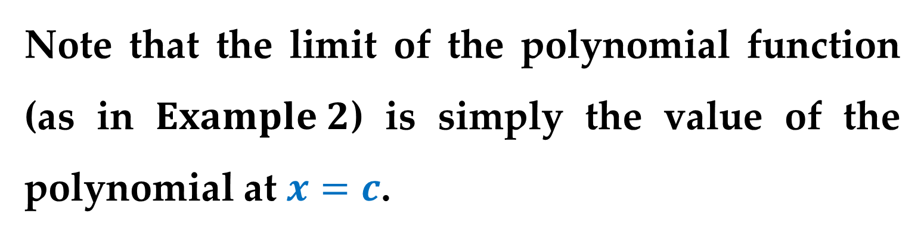
Conclusion
Note that the limit of the polynomial function (as in $Example 2$) is simply the value of the polynomial at $x=c$.
This direct substitution property is valid for all polynomial and rational functions with nonzero denominators.

Slide 10
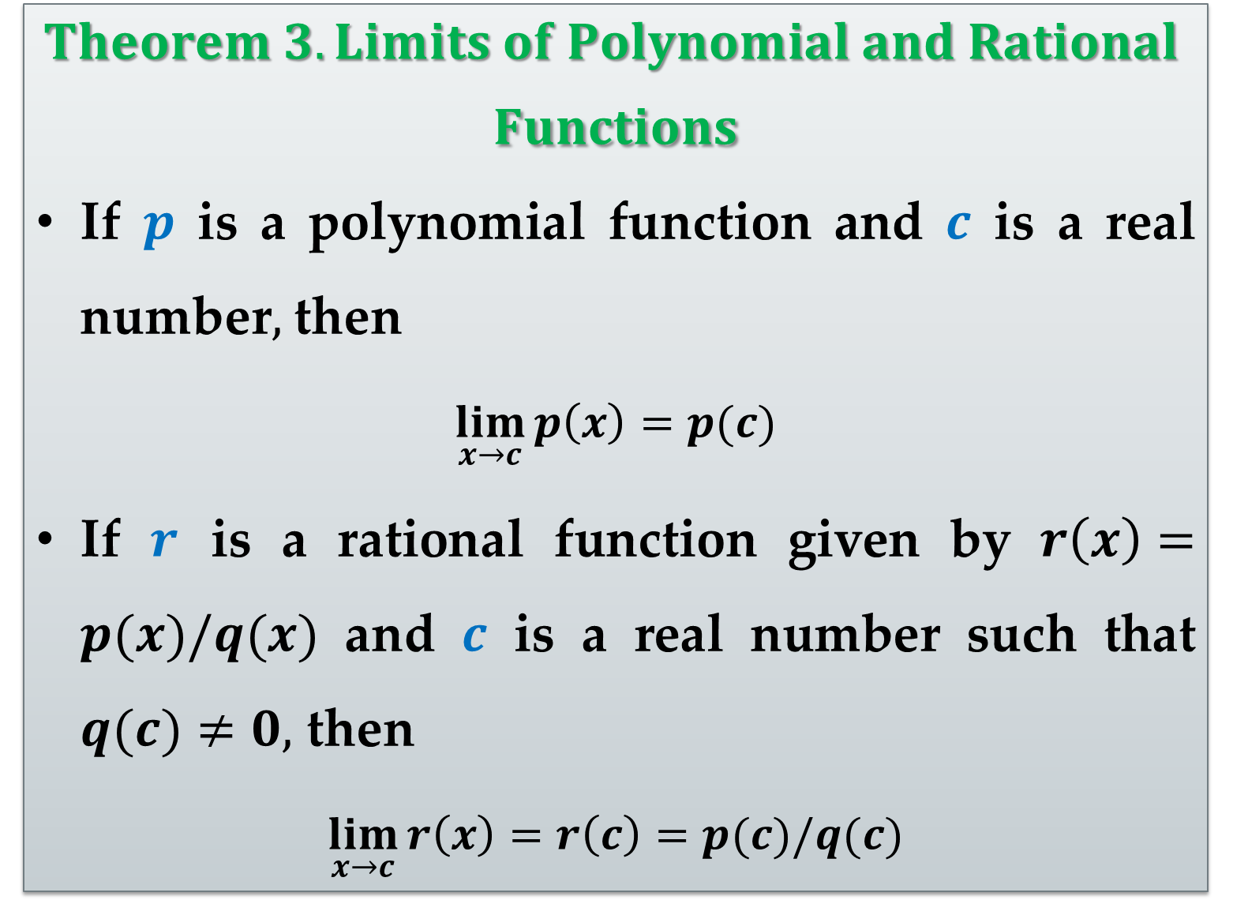
$$Theorem 3. Limits of Polynomial and Rational$$
$$Functions$$
If $p$ is a polynomial function and $c$ is a real number$,$ then
$$\lim_{x→c}{p\left(x\right)=p(c)}$$
If $r$ is a rational function given by $r\left(x\right)=p(x)/q(x)$ and $c$ is a real number such that $q(c)≠0,$ then
$$\lim_{x→c}{r\left(x\right)=r\left(c\right)=p(c)/q(c)}$$

Slide 11
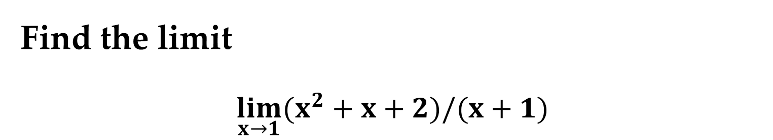
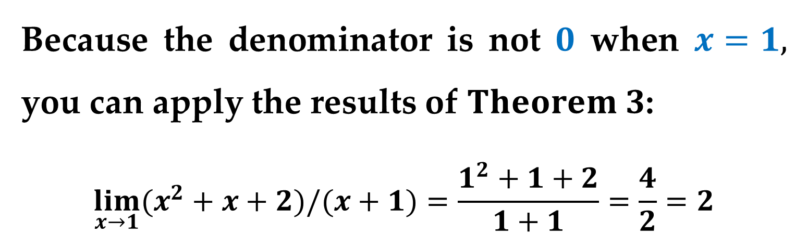
Example 3. The Limit of a Rational Function
Find the limit
$$\lim_{x→1}{(x^{2}+x+2)/(x+1)}$$
Solution
Because the denominator is not $0$ when $x=1,$ you can apply the results of $Theorem 3$:
$$\lim_{x→1}{(x^{2}+x+2)/(x+1)}=\frac{1^{2}+1+2}{1+1}=\frac{4}{2}=2$$

Slide 12
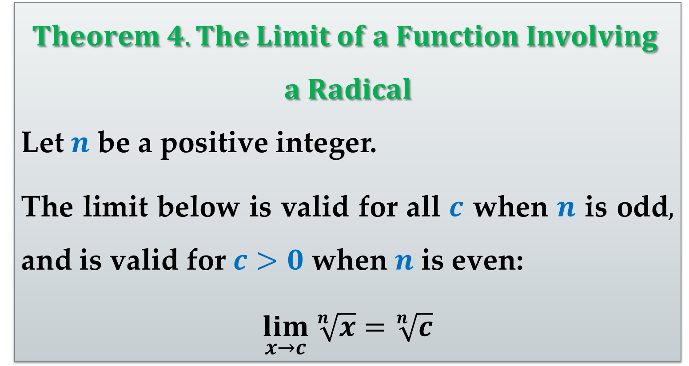
$$Theorem 4. The Limit of a Function Involving$$
$$a Radical$$
Let $n$ be a positive integer.
The limit below is valid for all $c$ when $n$ is odd$,$ and is valid for $c>0$ when $n$ is even:
$$\lim_{x→c} \sqrt[n]{x}{=\sqrt[n]{c}}$$

Slide 13
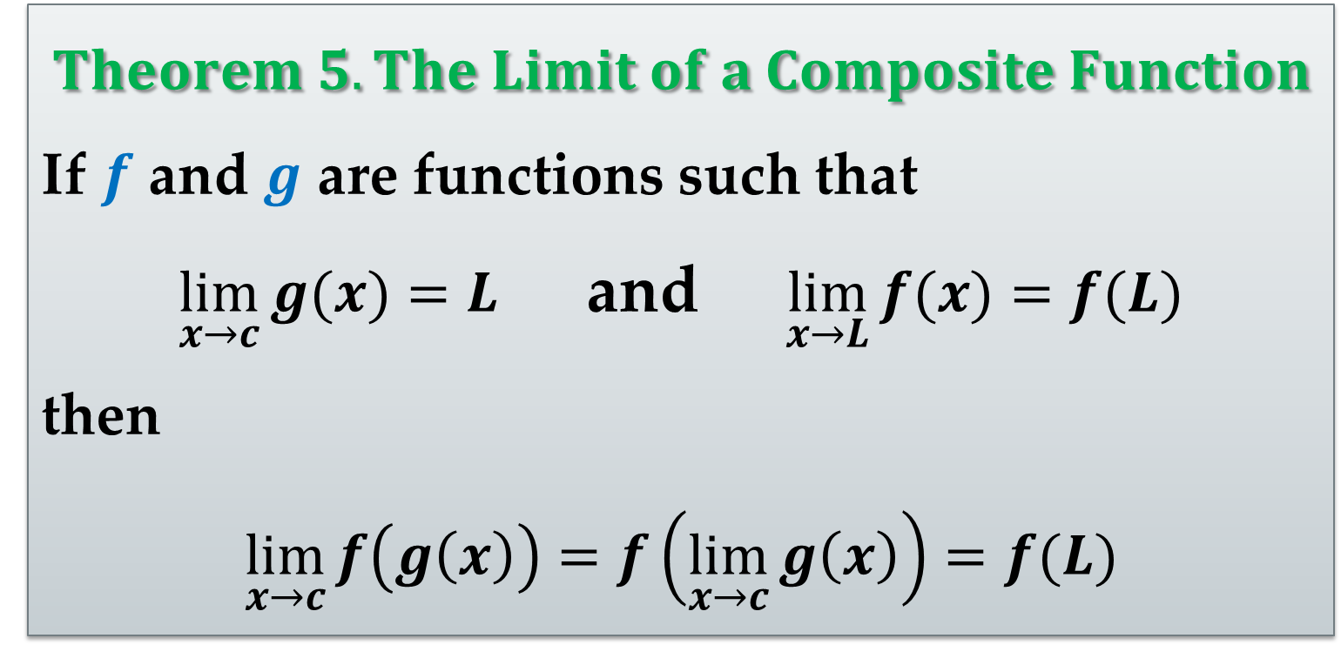
$$Theorem 5. The Limit of a Composite Function$$
If $f$ and $g$ are functions such that
$\lim_{x→c}{g(x)}=L$ and $\lim_{x→L}{f(x)}=f(L)$
then
$$\lim_{x→c}{f\left(g\left(x\right)\right)}=f\left(\lim_{x→c}{g\left(x\right)}\right)=f(L)$$

Slide 14
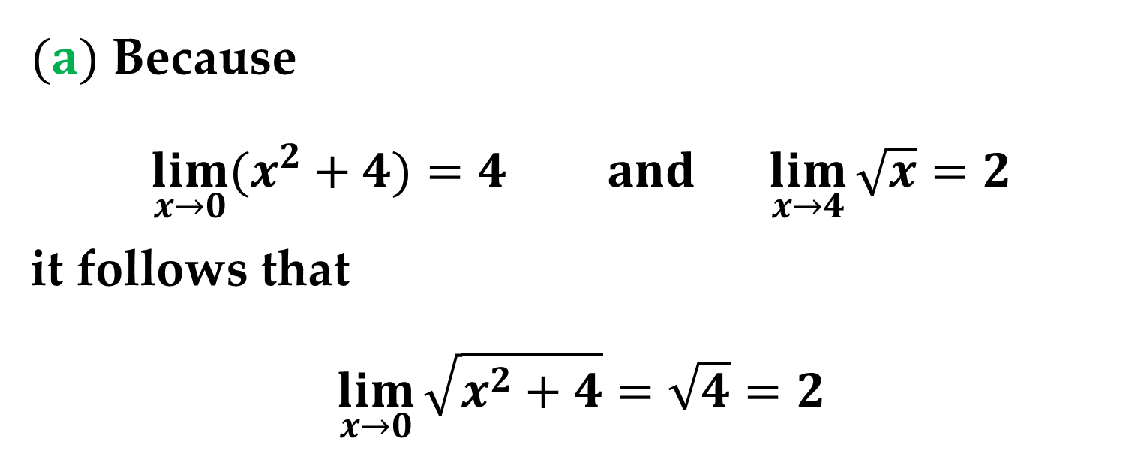
Example 4. The Limit of a Composite Function
Find the limits of the following composite functions.
$(a)$ Because
$$\lim_{x→0}{(x^{2}+4)}=4 and \lim_{x→4}{\sqrt{x}}=2$$
it follows that
$$\lim_{x→0}{\sqrt{x^{2}+4}}=\sqrt{4}=2$$

Slide 15

Example 4. The Limit of a Composite Function
$(b)$ Because
$$\lim_{x→3}{(2x^{2}−10)}=8 and \lim_{x→8}{\sqrt[3]{x}}=2$$
it follows that
$$\lim_{x→3}{\sqrt[3]{2x^{2}−10}}=\sqrt[3]{8}=2$$
You have seen that the limits of many algebraic functions can be evaluated by direct substitution.

Slide 16
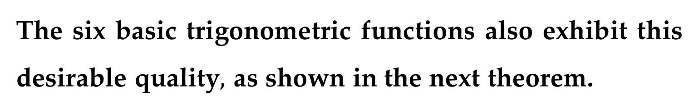
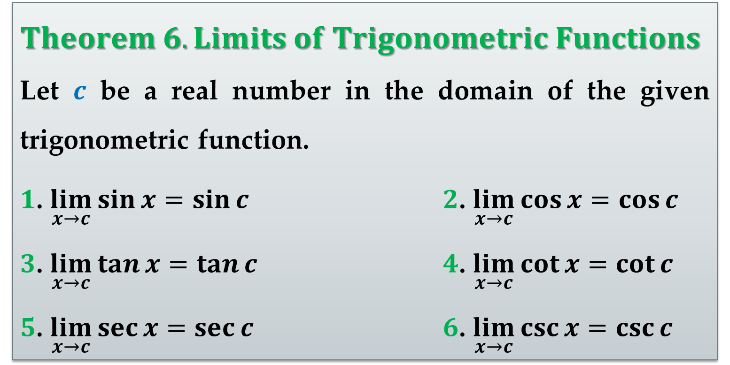
The six basic trigonometric functions also exhibit this desirable quality$,$ as shown in the next theorem.
$Theorem 6. Limits of Trigonometric Functions$
Let $c$ be a real number in the domain of the given trigonometric function.
$1$. $\lim_{x→c}{\sin{x}}=\sin{c}$ $2$. $\lim_{x→c}{\cos{x}}=\cos{c}$
$3$. $\lim_{x→c}{\tan{x}}=\tan{c}$ $4$. $\lim_{x→c}{\cot{x}}=\cot{c}$
$5$. $\lim_{x→c}{\sec{x}}=\sec{c}$ $6$. $\lim_{x→c}{\csc{x}}=\csc{c}$

Slide 17
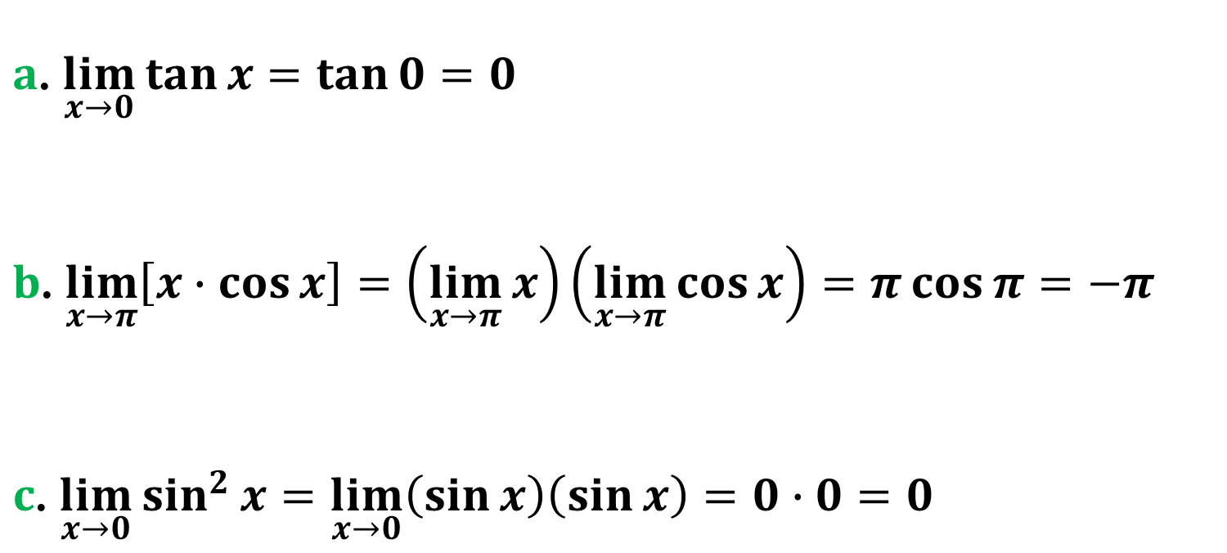
Example 5. Limits of Trigonometric Functions
Find the limits of the following trigonometric functions.
$a$. $\lim_{x→0}{\tan{x}}=\tan{0}=0$
$b$. $\lim_{x→π}\left[x∙cos{x}\right]=\left(\lim_{x→π}{x}\right)\left(\lim_{x→π}{\cos{x}}\right)=π\cos{π}=−π$
$c$. $\lim_{x→0}{\sin^{2}{x}}=\lim_{x→0}\left(\sin{x}\right)\left(\sin{x}\right)=0∙0=0$

Slide 18
A Strategy for Finding Limits

Slide 19
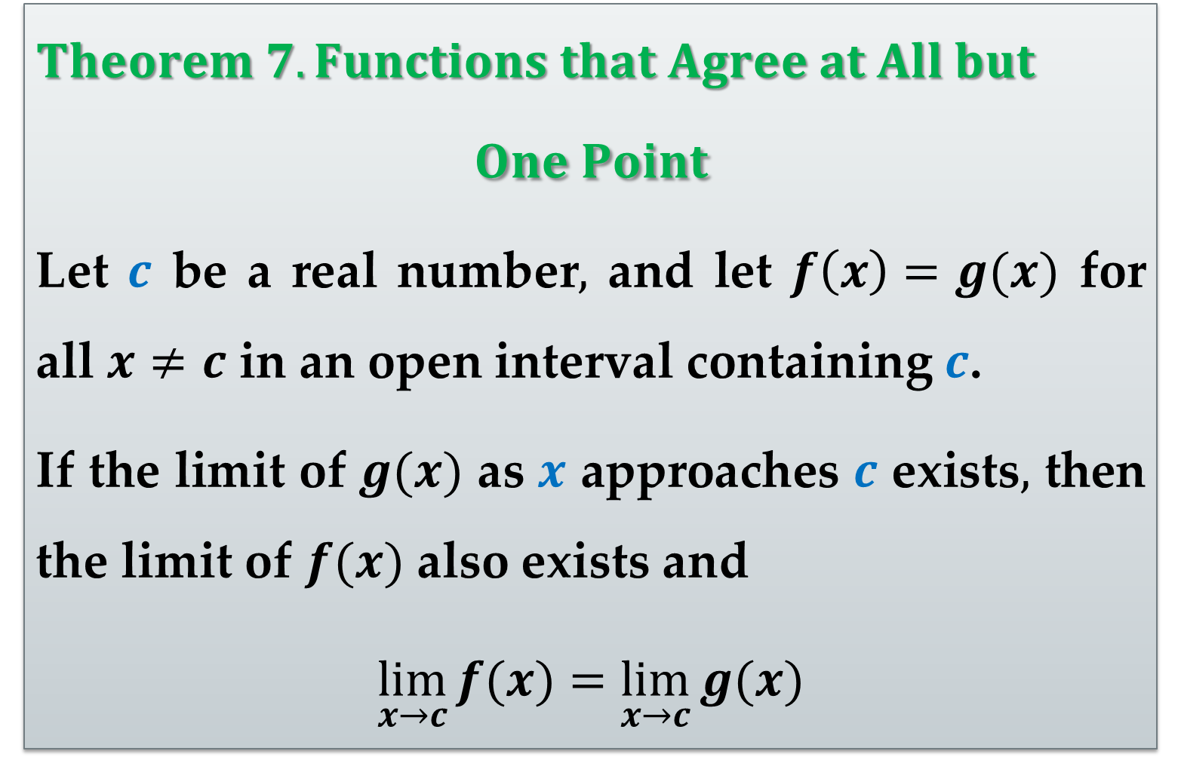
$Theorem 7. Functions that Agree at All but$
$$One Point$$
Let $c$ be a real number$,$ and let $f\left(x\right)=g(x)$ for all $x≠c$ in an open interval containing $c$.
If the limit of $g(x)$ as $x$ approaches $c$ exists$,$ then the limit of $f(x)$ also exists and
$$\lim_{x→c}{f(x)}=\lim_{x→c}{g(x)}$$

Slide 20
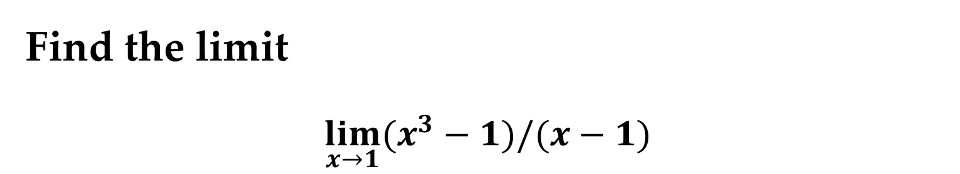
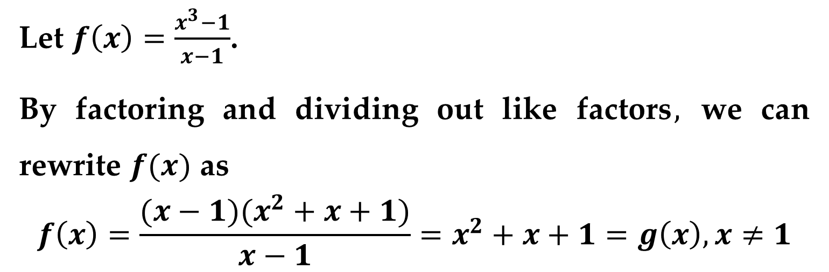
Example 6. Finding the Limit of a Function
Find the limit
$$\lim_{x→1}{(x^{3}−1)/(x−1)}$$
Solution
Let $f\left(x\right)=\frac{x^{3}−1}{x−1}$.
By factoring and dividing out like factors$,$ we can rewrite $f(x)$ as
$$f\left(x\right)=\frac{(x−1)(x^{2}+x+1)}{x−1}=x^{2}+x+1=g\left(x\right), x≠1$$

Slide 21
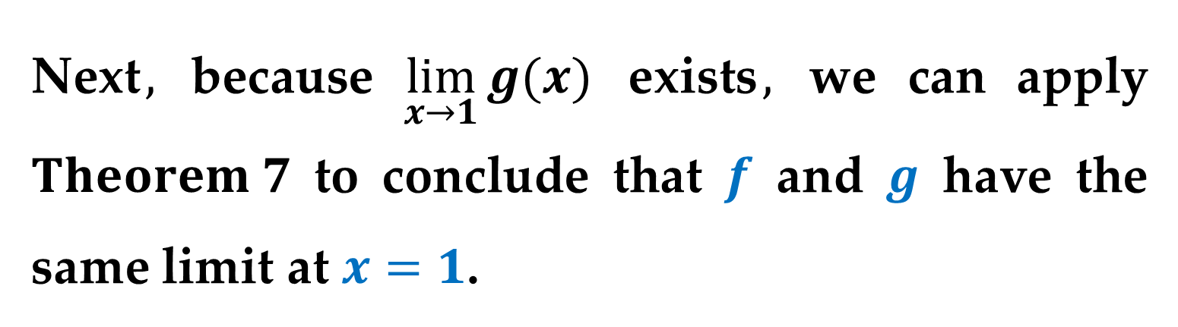
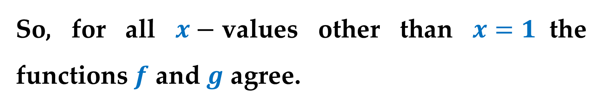
Solution (continued)
So, for all $x−$values other than $x=1$the functions $f$ and $g$ agree.
Next$,$ because $\lim_{x→1}{g(x)}$ exists$,$ we can apply $Theorem 7$ to conclude that $f$ and $g$ have the same limit at $x=1$.

Slide 22
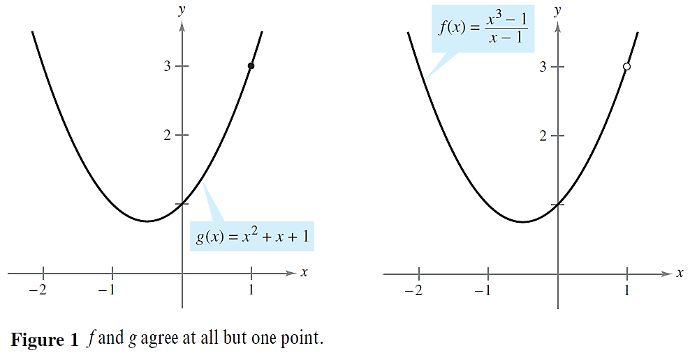
Solution (continued)
$$\lim_{x→1}{(x^{3}−1)/(x−1)}=\lim_{x→1}{{(x}^{2}+x+1)}=3$$

Slide 23
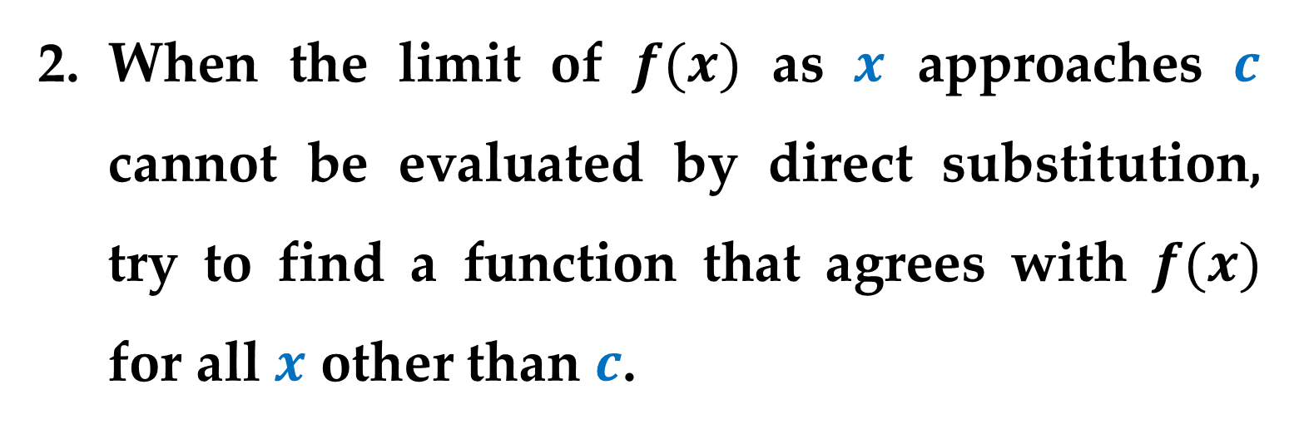
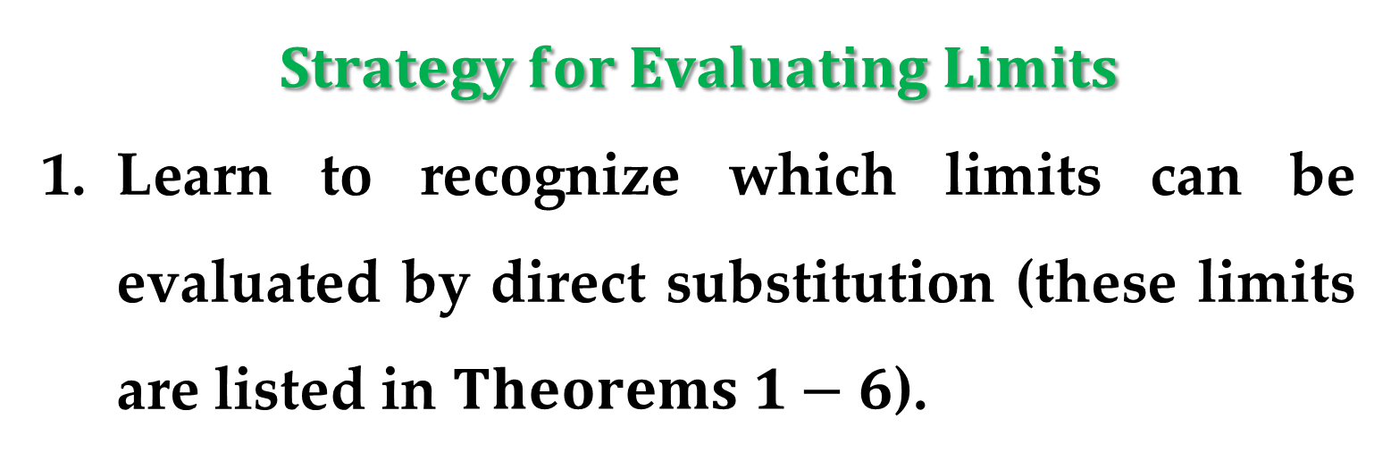
$$Strategy for Evaluating Limits$$
Learn to recognize which limits can be evaluated by direct substitution (these limits are listed in $Theorems 1−6$).
When the limit of $f(x)$ as $x$ approaches $c$ cannot be evaluated by direct substitution, try to find a function that agrees with $f(x)$ for all $x$ other than $c$.

Slide 24
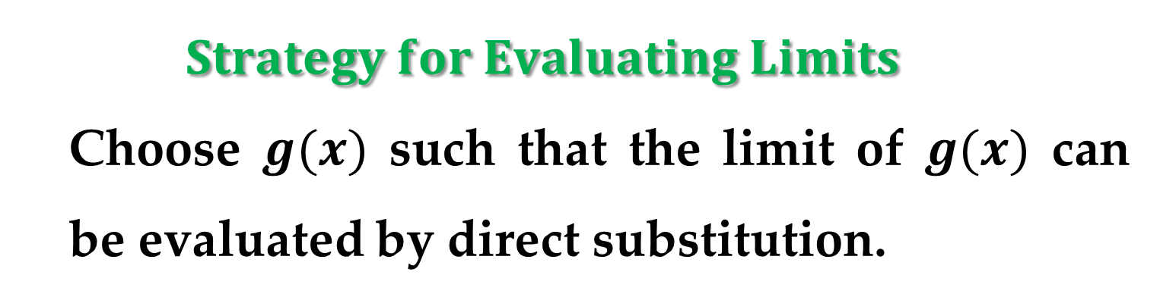
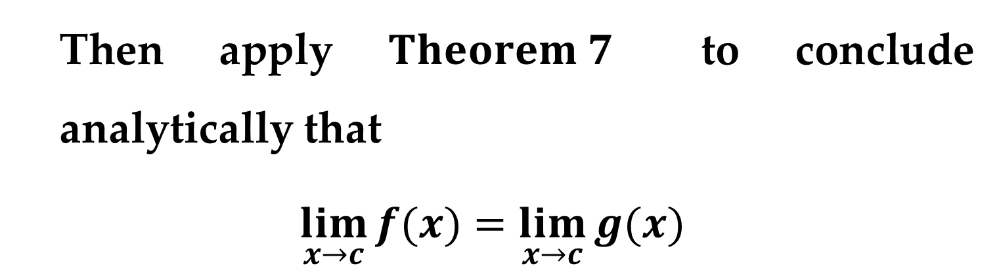
  $$Strategy for Evaluating Limits$$
  Choose $g(x)$ such that the limit of $g(x)$ can be evaluated by direct substitution.
  Then apply $Theorem 7$ to conclude analytically that
$$\lim_{x→c}{f(x)}=\lim_{x→c}{g(x)}$$
Use a graph or table to reinforce your conclusion.

Slide 25

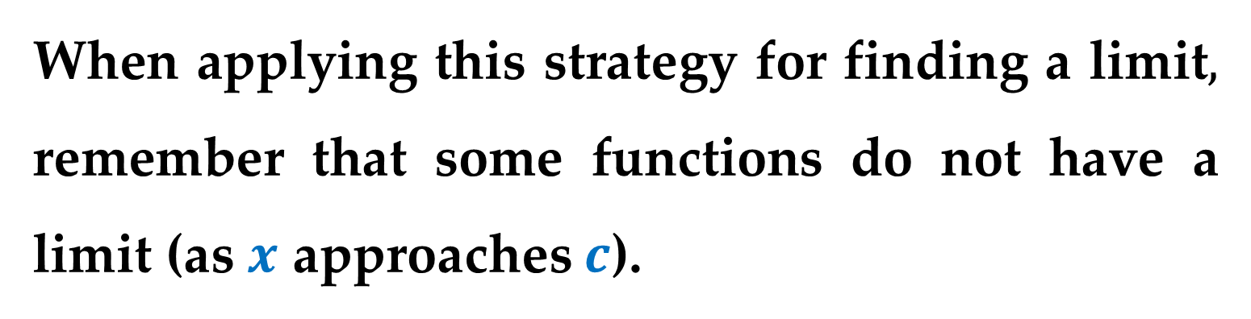
Remark
When applying this strategy for finding a limit$,$ remember that some functions do not have a limit (as $x$ approaches $c$).
For instance$,$ the limit below does not exist:
$$\lim_{x→1}{(x^{3}+1)/(x−1)}$$

Slide 26
Dividing Out and Rationalizing Techniques

Slide 27

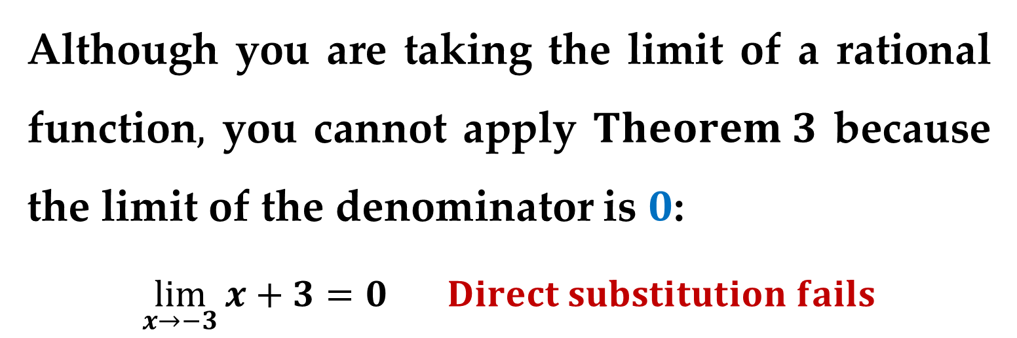
Example 7. Dividing Out Technique
Find the limit
$$\lim_{x→−3}{(x^{2}+x−6)/(x+3)}$$
Solution
Although you are taking the limit of a rational function$,$ you cannot apply $Theorem 3$ because the limit of the denominator is $0$:
$$\lim_{x→−3}{x+3}=0 Direct substitution fails$$

Slide 28
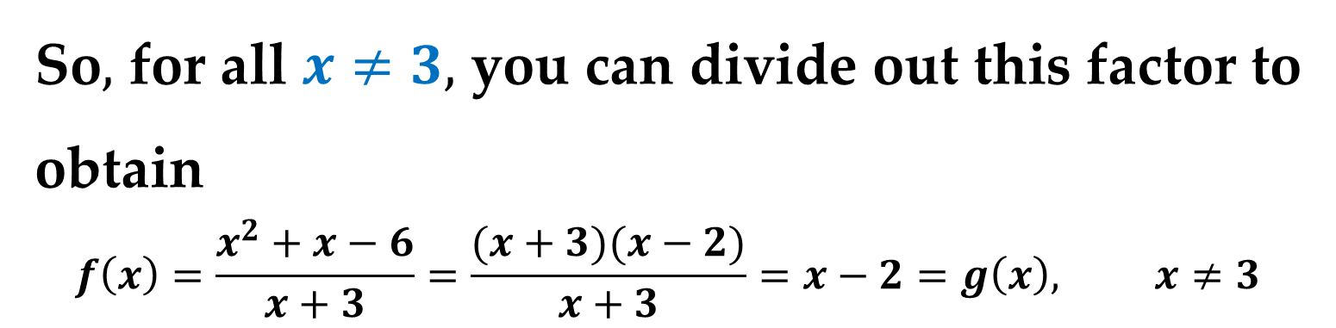
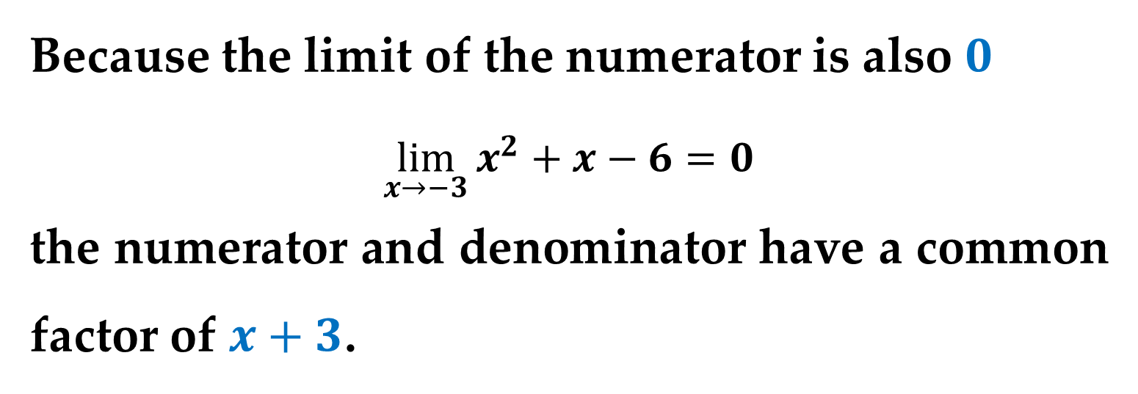
Solution (continued)
Because the limit of the numerator is also $0$
$$\lim_{x→−3}{x^{2}+x−6}=0$$
the numerator and denominator have a common factor of $x+3$.
So$,$ for all $x≠3,$ you can divide out this factor to obtain
$$f\left(x\right)=\frac{x^{2}+x−6}{x+3}=\frac{(x+3)(x−2)}{x+3}=x−2=g\left(x\right), x≠3$$

Slide 29
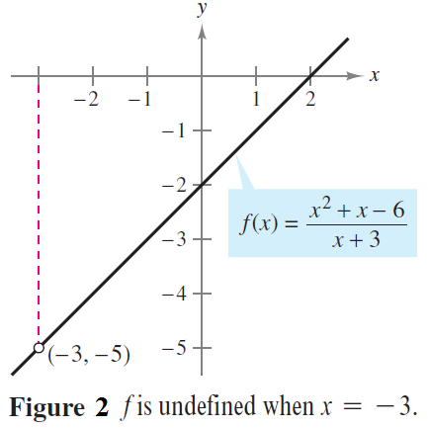
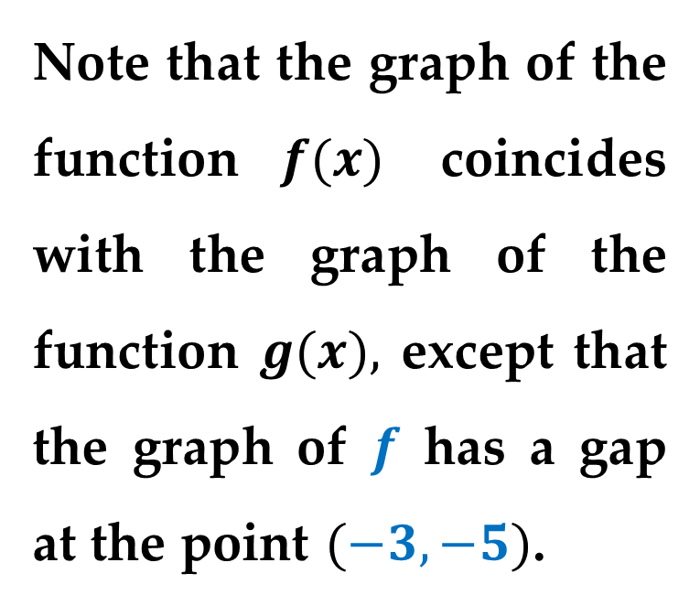
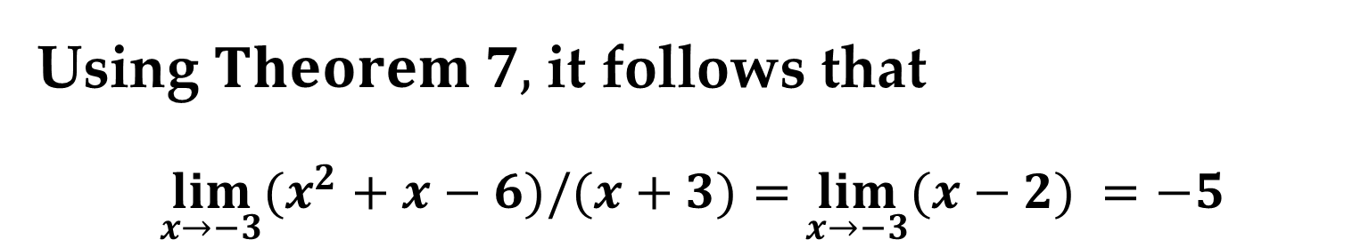
Solution (continued)
Using $Theorem 7,$ it follows that
$$\lim_{x→−3}{(x^{2}+x−6)/(x+3)}=\lim_{x→−3}{(x−2) }=−5$$
Note that the graph of the function $f(x)$ coincides with the graph of the function $g(x),$ except that the graph of $f$ has a gap at the point $(−3,−5)$.

Slide 30
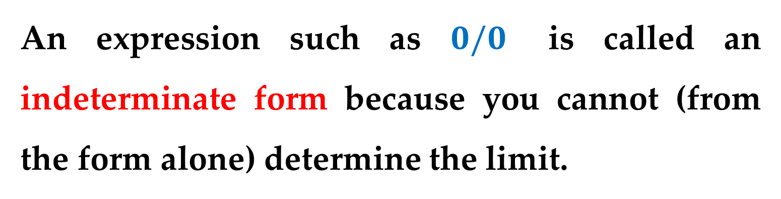
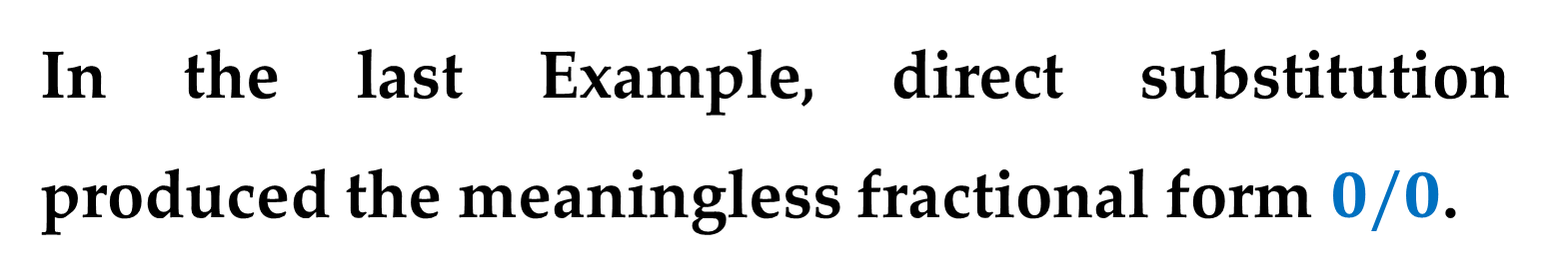
Remark
In the last Example, direct substitution produced the meaningless fractional form $0/0$.
An expression such as $0/0$ is called an indeterminate form because you cannot (from the form alone) determine the limit.

Slide 31
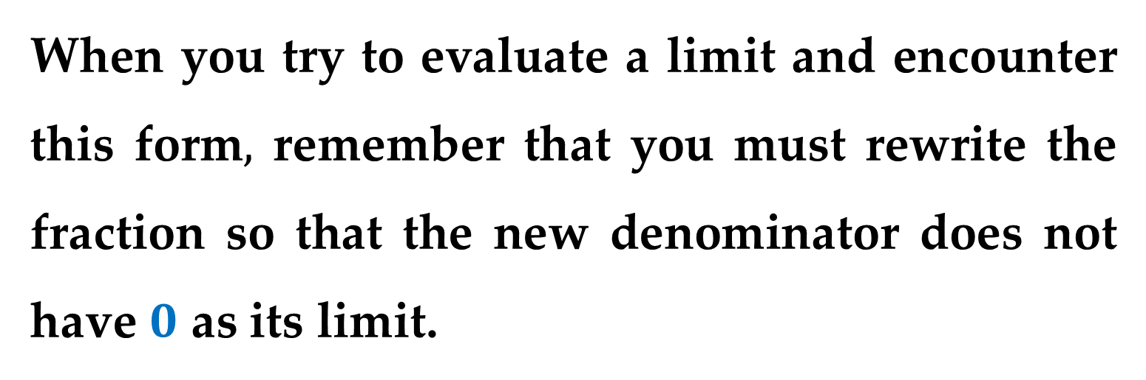
When you try to evaluate a limit and encounter this form$,$ remember that you must rewrite the fraction so that the new denominator does not have $0$ as its limit.
One way to do this is to divide out like factors.
Another way is to use the rationalizing technique shown next.

Slide 32
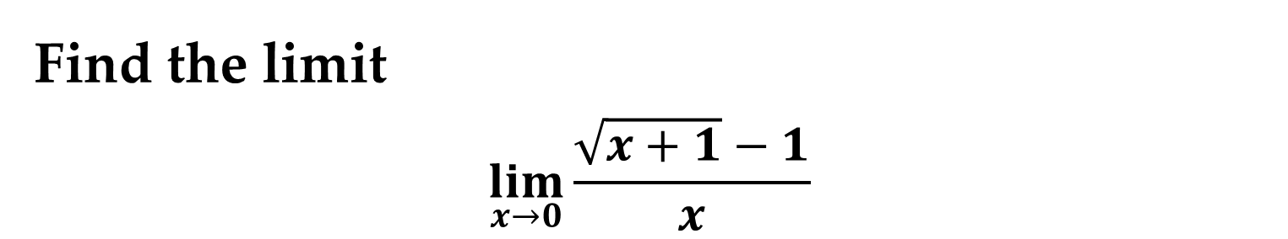
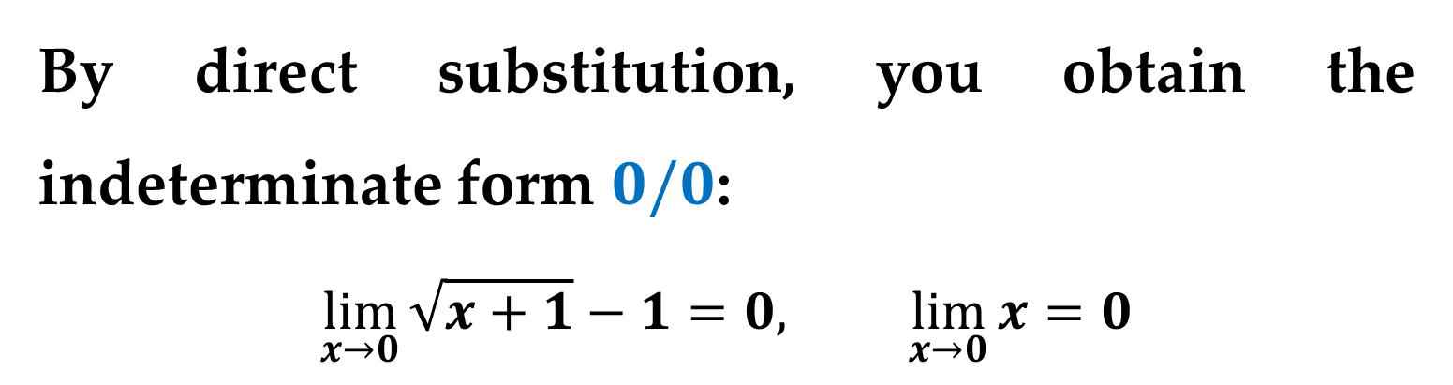
Example 8. Rationalizing Technique
Find the limit
$$\lim_{x→0}{\frac{\sqrt{x+1}−1}{x} }$$
Solution
By direct substitution, you obtain the indeterminate form $0/0$:
$$\lim_{x→0}{\sqrt{x+1}−1}=0, \lim_{x→0}{x}=0$$

Slide 33
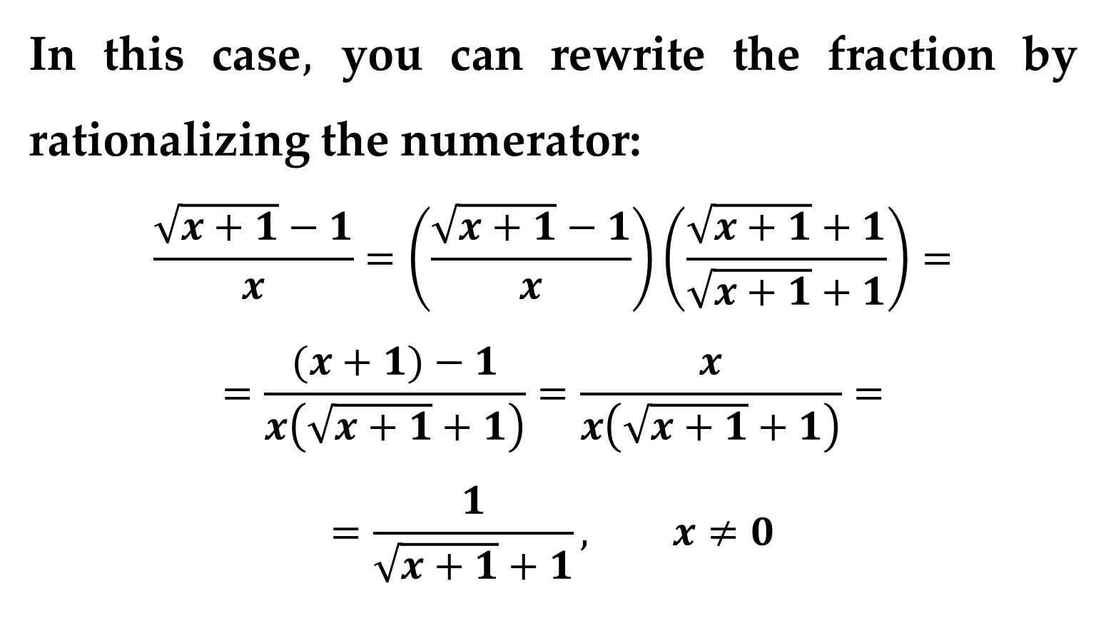
Solution (continued)
In this case$,$ you can rewrite the fraction by rationalizing the numerator:
$$\frac{\sqrt{x+1}−1}{x}=\left(\frac{\sqrt{x+1}−1}{x}\right)\left(\frac{\sqrt{x+1}+1}{\sqrt{x+1}+1}\right)=$$
$$=\frac{(x+1)−1}{x\left(\sqrt{x+1}+1\right)}=\frac{x}{x\left(\sqrt{x+1}+1\right)}=$$
$$=\frac{1}{\sqrt{x+1}+1}, x≠0$$

Slide 34
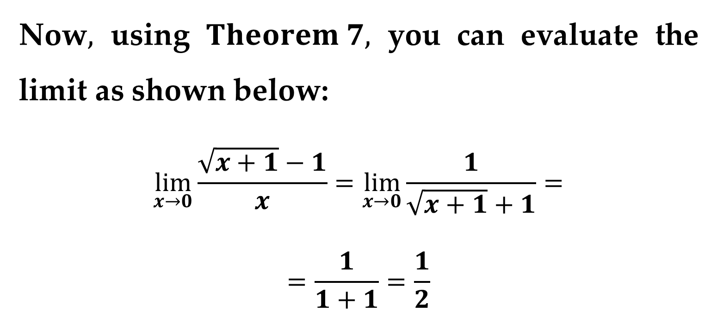
Solution (continued)
Now$,$ using $Theorem 7,$ you can evaluate the limit as shown below:
$$\lim_{x→0}{\frac{\sqrt{x+1}−1}{x}}=\lim_{x→0}{\frac{1}{\sqrt{x+1}+1}}=$$
$$=\frac{1}{1+1}=\frac{1}{2}$$

Slide 35
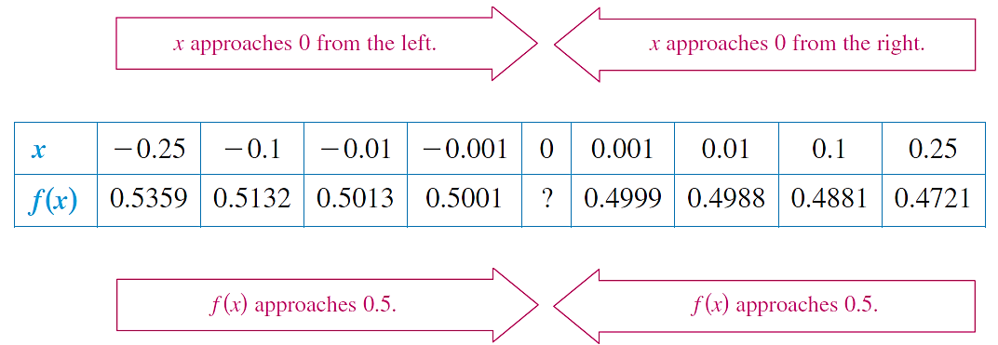
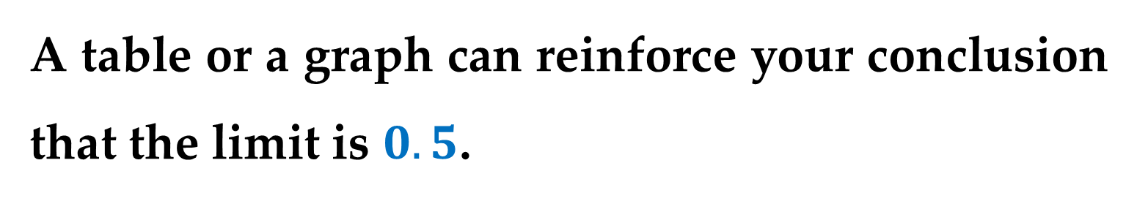
Solution (continued)
A table or a graph can reinforce your conclusion that the limit is $0.5$.

Slide 36
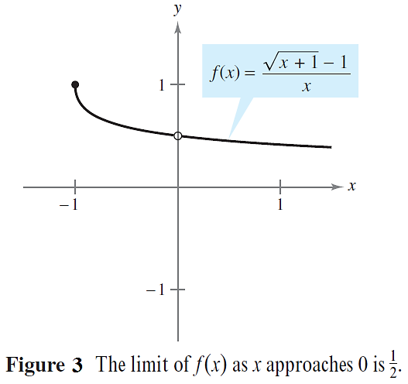
Solution (continued)

Slide 37
The Squeeze Theorem

Slide 38
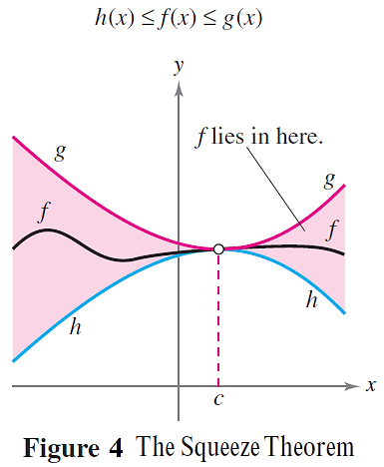
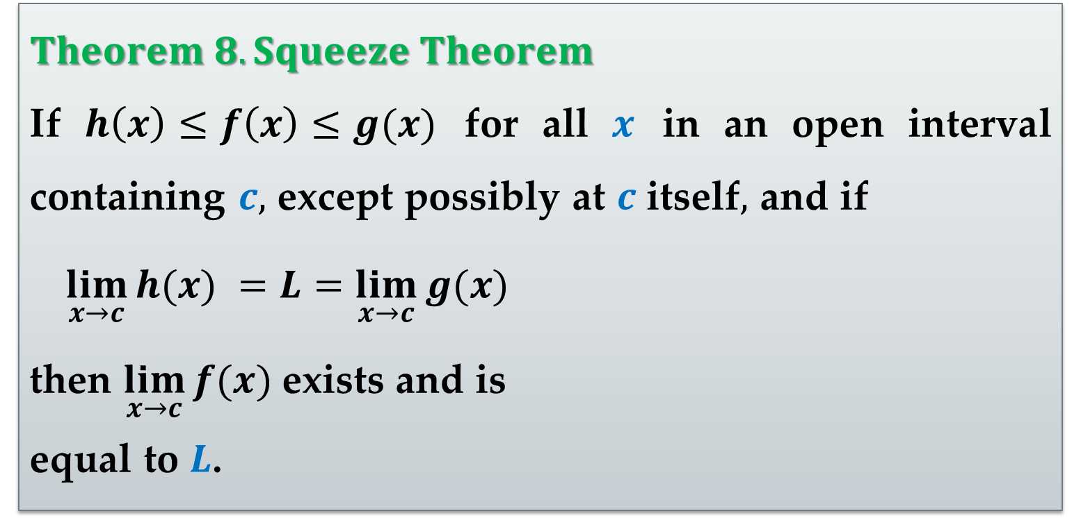
$Theorem 8. Squeeze Theorem$
If $h\left(x\right)≤f\left(x\right)≤g(x)$ for all $x$ in an open interval containing $c,$ except possibly at $c$ itself$,$ and if
$\lim_{x→c}{h(x) }=L=\lim_{x→c}{g(x) }$
then $\lim_{x→c}{f(x) }$exists and is
equal to $L$.

Slide 39
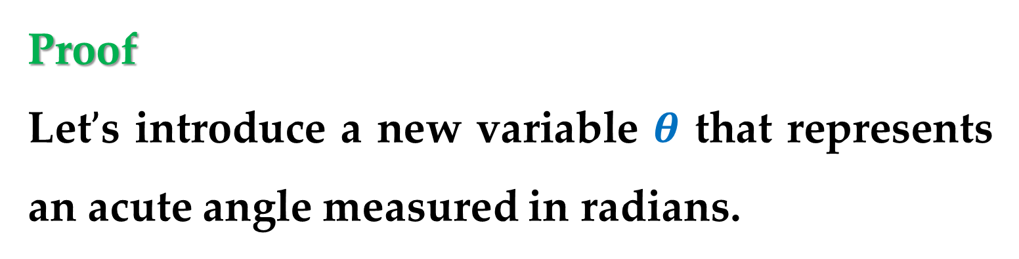
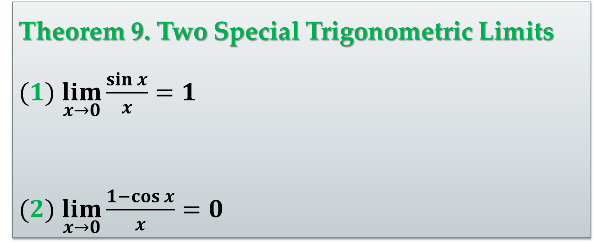
Theorem 9. Two Special Trigonometric Limits
$(1)$ $\lim_{x→0}{\frac{\sin{x}}{x}}=1$
$(2)$ $\lim_{x→0}{\frac{1−\cos{x}}{x}}=0$
Proof
Let$’$s introduce a new variable $θ$ that represents an acute angle measured in radians.

Slide 40
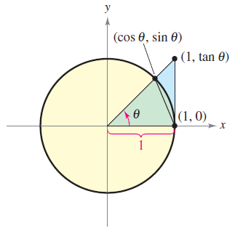

Proof (continued)
Consider a circular sector that is squeezed between two triangles.
Evaluating the areas of the two triangles and the sector produces the following inequality

Slide 41


Proof (continued)
Multiplying each expression in the above inequality by $\frac{2}{\sin{θ}}$ produces
$$\frac{1}{\cos{θ}}≥\frac{θ}{\sin{θ}}≥1$$
Taking reciprocals and reversing the inequalities yields
$$\cos{θ}≤\frac{\sin{θ}}{θ}≤1$$

Slide 42

Proof (continued)
Because
$$\cos{θ}=\cos{(−θ)}$$
and
$$\frac{\sin{θ}}{θ}=\frac{\sin{(−θ)}}{−θ}$$
we can conclude that this inequality is valid for all nonzero $θ$ in the open interval $\left(−\frac{π}{2},\frac{π}{2}\right)$.

Slide 43

Proof (continued)
Finally$,$ because
$$\lim_{θ→0}{\cos{θ}=1} and \lim_{θ→0}{1}=1$$
we can apply the Squeeze Theorem to conclude that
$$\lim_{θ→0}{\frac{\sin{θ}}{θ}=1}$$
This completes the proof of the Theorem. 

Slide 44


Example 9. A Limit Involving a Trigonometric Function
Find the limit
$$\lim_{x→0}{\frac{\tan{x}}{x}}$$
Solution
Direct substitution yields the indeterminate form $0/0$. To solve this problem$,$ you can write $\tan{x}$ as $\sin{x}/\cos{x}$ and obtain
$$\lim_{x→0}{\tan{x}/x }=\lim_{x→0}{(\sin{x}/x)(1/\cos{x}) }$$

Slide 45

Solution (continued)
Now$,$ because
$$\lim_{x→0}\left(\frac{\sin{x}}{x}\right)=1$$
and
$$\lim_{x→0}\left(\frac{1}{\cos{x}}\right)=1,$$
you can obtain
$$\lim_{x→0}{\frac{\tan{x}}{x}}=1∙1=1$$

Slide 46

Example 10. A Limit Involving a Trigonometric Function
Find the limit
$$\lim_{x→0}{\frac{\sin{x}\left(1−\cos{x}\right)}{2x^{2}}}$$
$$∗∗∗$$

Slide 47
Thank you for attention

